Slide 1

An Introduction to the Synergy of Deep Learning and Differential Equations
Seminar
Presented by: Federico Berto
Date: 2021-12-19
1
Notes:
Hello everyone!
My name is Federico Berto and today I am going to present together with Chuanbo Hua our Final Project for this course: “Graph Collocation Networks for Partial Differential Equations”

Slide 2
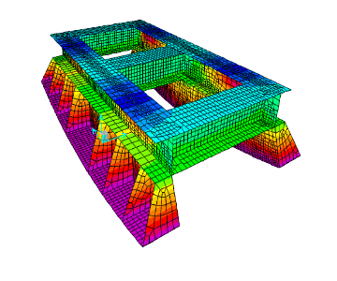
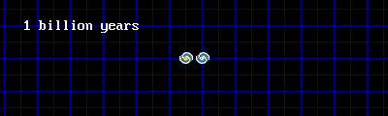

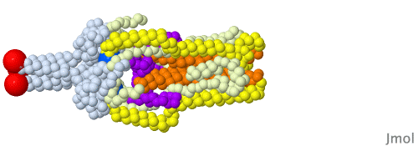
Motivation
Differential equations are the language of nature
Prominent role in many disciplines including engineering, physics, economics, and biology
Engineering: Structural analysis with finite element method
Physics: universe expansion
Finance: Black Scholes pricing model
Biology: Spike protein transformation in Covid-19
2
Notes:
We get our motivation from the theory of Differential Equations which can be seen as the language of nature and play a prominent role in many disciplines
While classical approaches have been widely used, some of them can be extremely slow or even fail altogether to represent Partial Differential Equations (PDE) behavior
However, since many systems are naturally expressed as graphs, Graph Neural Networks can help to enhance the simulations!

Slide 3
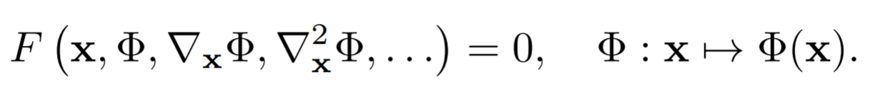
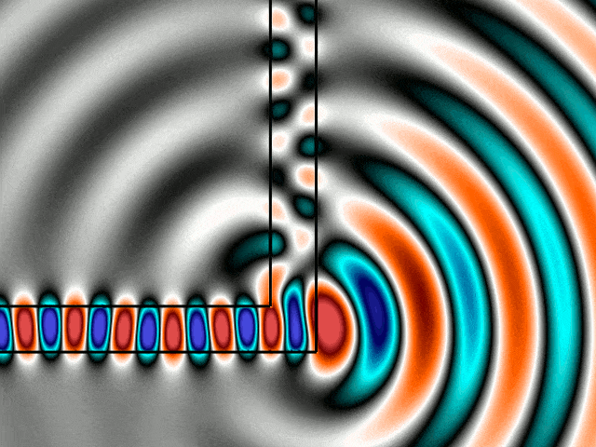
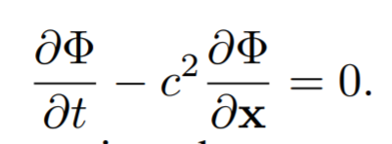
What is a Differential Equation?
A function that takes as input the spatial or spatio-temporal coordinates x and, optionally, derivatives of the unknown Φ with respect to these coordinates
Implicit Formulation of a Differential Equation
An example from physics
Helmoltz Wave Equation
3
Notes:
We get our motivation from the theory of Differential Equations which can be seen as the language of nature and play a prominent role in many disciplines
While classical approaches have been widely used, some of them can be extremely slow or even fail altogether to represent Partial Differential Equations (PDE) behavior
However, since many systems are naturally expressed as graphs, Graph Neural Networks can help to enhance the simulations!

Slide 4
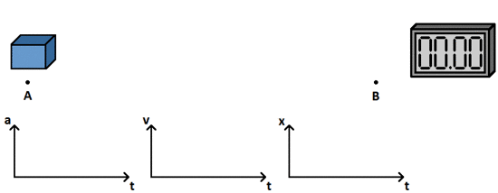
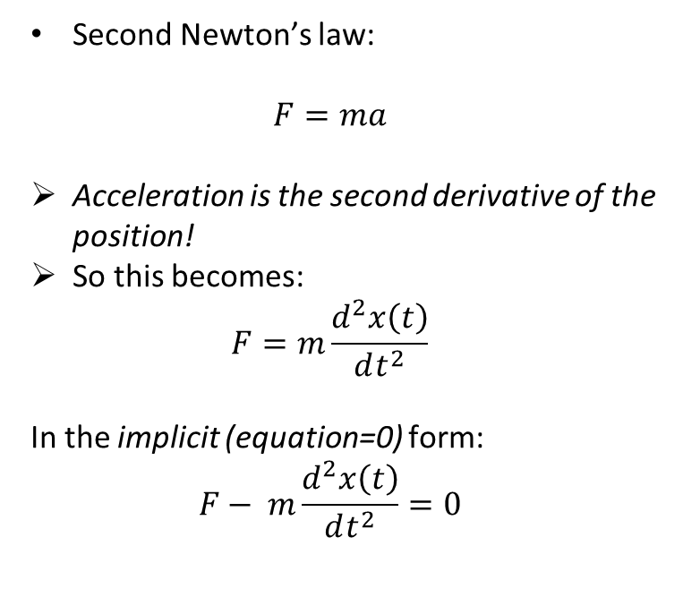
A More Familiar Example
Second Newton’s law:
$$F=ma$$
Acceleration is the second derivative of the position!
So this becomes:
$$F=m\frac{d^{2}x\left(t\right)}{dt^{2}}$$
In the implicit (equation=0) form:
$$F− m\frac{d^{2}x\left(t\right)}{dt^{2}}=0$$
Massive object subject to a force
4
Notes:
We get our motivation from the theory of Differential Equations which can be seen as the language of nature and play a prominent role in many disciplines
While classical approaches have been widely used, some of them can be extremely slow or even fail altogether to represent Partial Differential Equations (PDE) behavior
However, since many systems are naturally expressed as graphs, Graph Neural Networks can help to enhance the simulations!

Slide 5
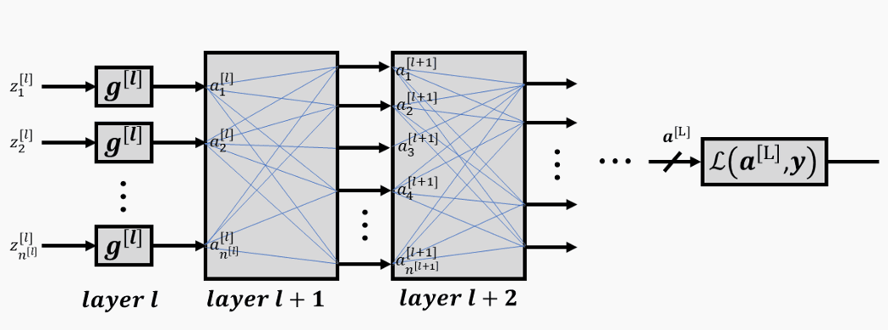
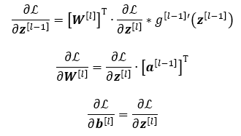
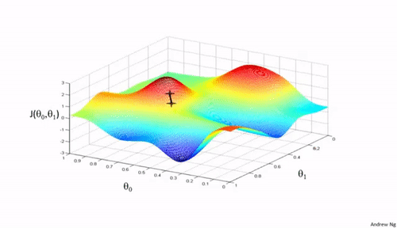
Backpropagation
Deep Learning is deeply intertwined with Differential Equations with the backpropagation
We use information of the gradients to update a network parameters!
Gradient descent in 2 dimensions
5
Notes:
We get our motivation from the theory of Differential Equations which can be seen as the language of nature and play a prominent role in many disciplines
While classical approaches have been widely used, some of them can be extremely slow or even fail altogether to represent Partial Differential Equations (PDE) behavior
However, since many systems are naturally expressed as graphs, Graph Neural Networks can help to enhance the simulations!

Slide 6
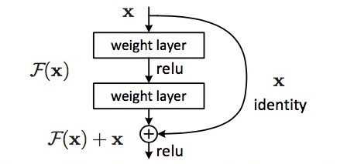

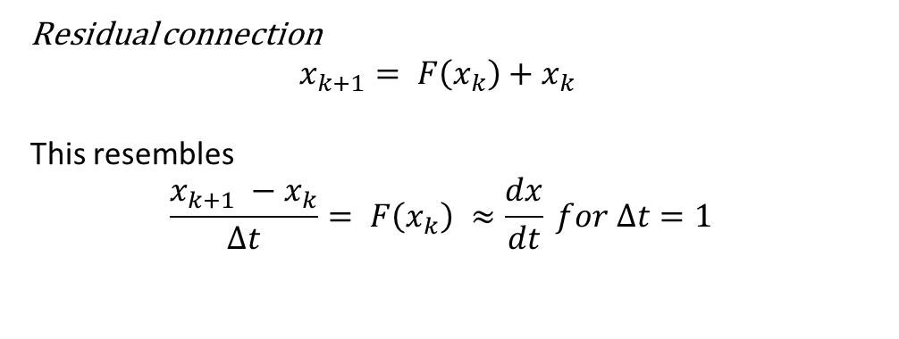
Neural Ordinary Differential Equations
ResNet [1] have skip connections between layers
Residual connection
$$x_{k+1}= F\left(x_{k}\right)+x_{k}$$
This resembles
$$\frac{x_{k+1} −x_{k}}{Δt}= F\left(x_{k}\right) ≈\frac{dx}{dt} for Δt=1$$
We can build Neural Ordinary Differential Equations [2](Neural ODEs)!
Networks tied to numerical solver with inference model:
$$x_{T}=x_{0}+\int_{0}^{T}{F_{θ}\left(t, x\left(t\right)\right)dt}$$
[1] Kaiming, et al. Deep residual learning for image recognition. In: Proceedings of the IEEE conference on computer vision and pattern recognition. 2016. p. 770-778.
[2] CHEN, Ricky TQ, et al. Neural ordinary differential equations. NeurIPS 2018
6
Notes:
We get our motivation from the theory of Differential Equations which can be seen as the language of nature and play a prominent role in many disciplines
While classical approaches have been widely used, some of them can be extremely slow or even fail altogether to represent Partial Differential Equations (PDE) behavior
However, since many systems are naturally expressed as graphs, Graph Neural Networks can help to enhance the simulations!

Slide 7
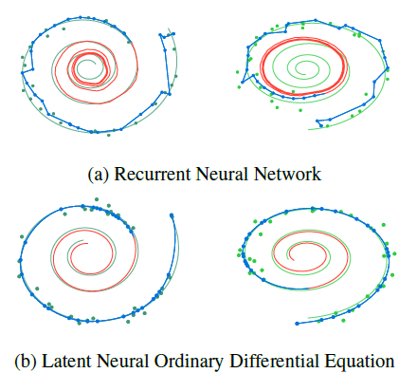
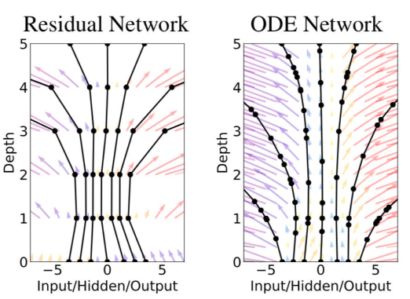

Neural Ordinary Differential Equations
Networks tied to numerical solver with inference model:
$$x_{T}=x_{0}+\int_{0}^{T}{F_{θ}\left(t, x\left(t\right)\right)dt}$$
7
Notes:
We get our motivation from the theory of Differential Equations which can be seen as the language of nature and play a prominent role in many disciplines
While classical approaches have been widely used, some of them can be extremely slow or even fail altogether to represent Partial Differential Equations (PDE) behavior
However, since many systems are naturally expressed as graphs, Graph Neural Networks can help to enhance the simulations!

Slide 8
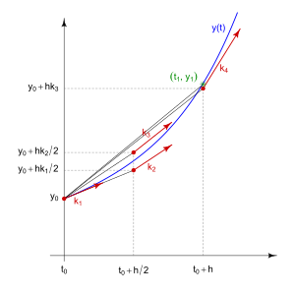
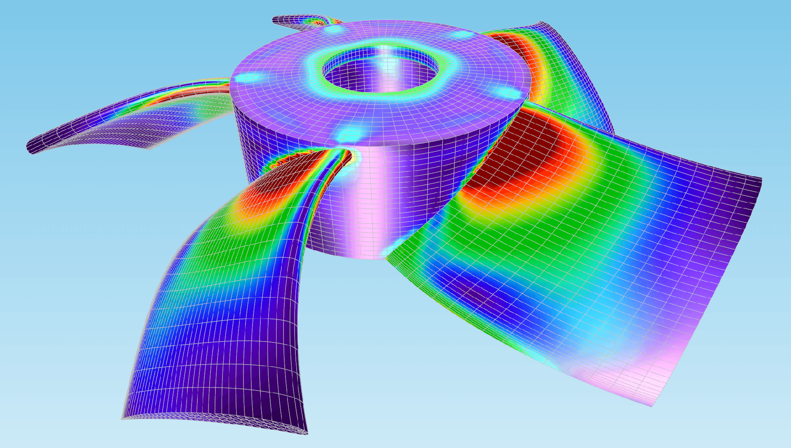
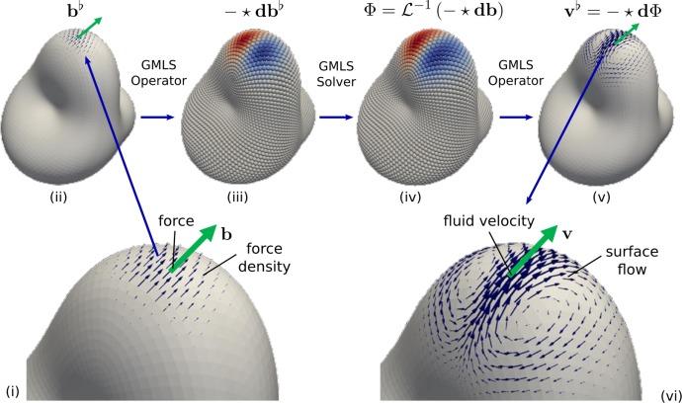
Physics Simulation
Classical approaches can be extremely slow or even fail to represent complex behaviors
Need to choose the right step sizes
If adaptive solvers are used, it may take too long to solve and simulate a physics process
Also, discretizations are inherently “wrong” → physics are mostly continuous!
Runge-Kutta method for ODEs
Finite Element Method (FEM)
Mesh-free methods (e.g. particle)
8
Notes:
We get our motivation from the theory of Differential Equations which can be seen as the language of nature and play a prominent role in many disciplines
While classical approaches have been widely used, some of them can be extremely slow or even fail altogether to represent Partial Differential Equations (PDE) behavior
However, since many systems are naturally expressed as graphs, Graph Neural Networks can help to enhance the simulations!

Slide 9
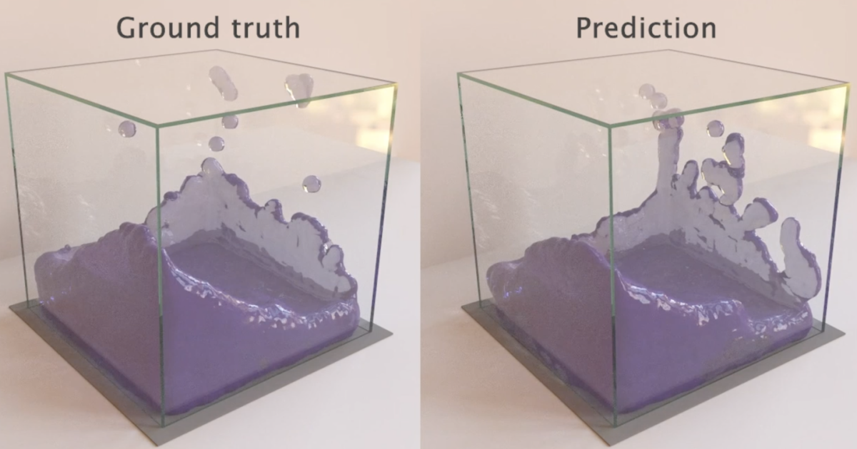
Learning Simulations
Engineered simulators
Substantial effort to build
Substantial resources to run
Only as accurate as the model
Not always suitable for solving inverse problems
Learned simulators
Reusable general architectures
Can be directly optimized for efficiency
Can be as accurate as the available data
Gradient-based search for control, inference, etc

Slide 10
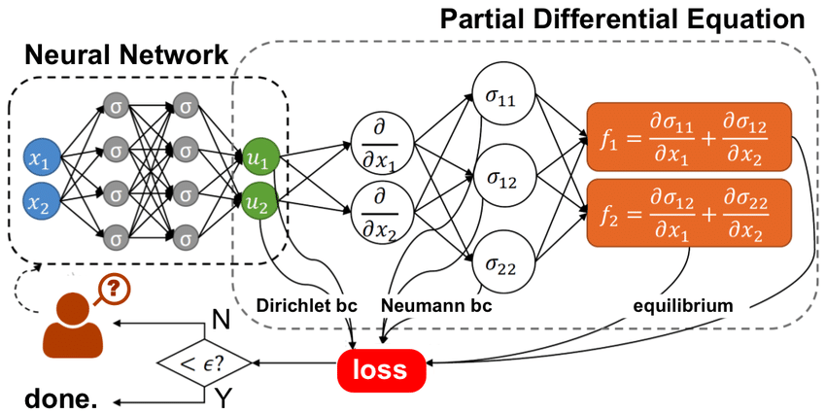
Physics Informed Neural Networks
What if we use Deep Learning to solve Differential Equations?
PINNs: Physics Informed Neural Networks[1]
[1] RAISSI, Maziar; PERDIKARIS, Paris; KARNIADAKIS, George E. Physics-informed neural networks: A deep learning framework for solving forward and inverse problems involving nonlinear partial differential equations. Journal of Computational Physics, 2019, 378: 686-707.
10
Notes:
We get our motivation from the theory of Differential Equations which can be seen as the language of nature and play a prominent role in many disciplines
While classical approaches have been widely used, some of them can be extremely slow or even fail altogether to represent Partial Differential Equations (PDE) behavior
However, since many systems are naturally expressed as graphs, Graph Neural Networks can help to enhance the simulations!

Slide 11
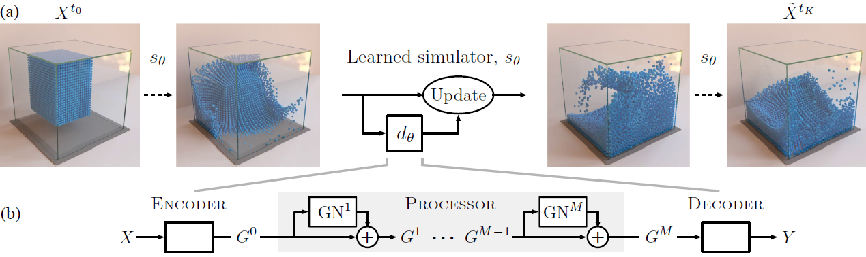
Graph Networks Simulators
Many problems can can be discretized in particles or mesh points
What If we use Graphs Networks to model these interactions?
GNS: Graph-based Neural Simulators [1]
A graph of neighboring particles is created ar
[1] Sanchez-Gonzalez, Alvaro, et al. "Learning to simulate complex physics with graph networks." International Conference on Machine Learning. PMLR, 2020
11
Notes:
We get our motivation from the theory of Differential Equations which can be seen as the language of nature and play a prominent role in many disciplines
While classical approaches have been widely used, some of them can be extremely slow or even fail altogether to represent Partial Differential Equations (PDE) behavior
However, since many systems are naturally expressed as graphs, Graph Neural Networks can help to enhance the simulations!

Slide 12
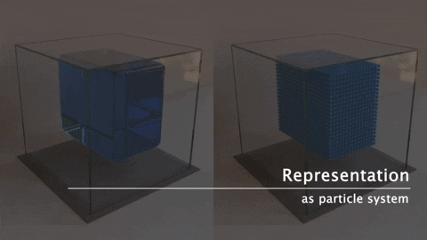
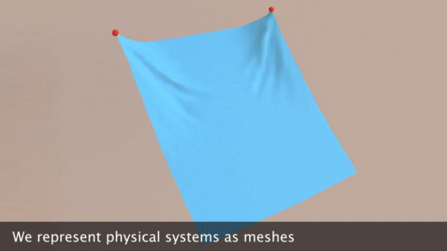
Graph Networks Simulators
GNS: Graph-based Neural Simulators [1]
We can also expand to mesh-based models [2]
[1] Sanchez-Gonzalez, Alvaro, et al. "Learning to simulate complex physics with graph networks." International Conference on Machine Learning. PMLR, 2020
.
[2] Pfaff, Tobias, et al. "Learning mesh-based simulation with graph networks." International Conference on Learning Representations. ICLR, 2021
12
Notes:
We get our motivation from the theory of Differential Equations which can be seen as the language of nature and play a prominent role in many disciplines
While classical approaches have been widely used, some of them can be extremely slow or even fail altogether to represent Partial Differential Equations (PDE) behavior
However, since many systems are naturally expressed as graphs, Graph Neural Networks can help to enhance the simulations!

Slide 13
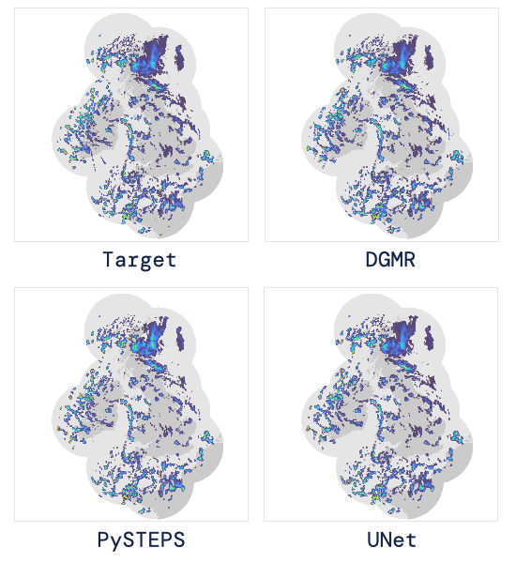
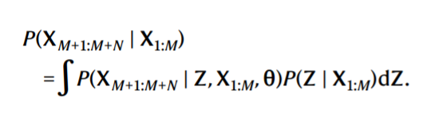
Latest Advances: Blazing Fast Weather Simulation
Deepmind has created a weather model which is thousand of times faster than numerical simulations [1]
Yet, it can forecast weather almost perfectly!
Radar model in differential form
[1] RAVURI, Suman, et al. Skillful Precipitation Nowcasting using Deep Generative Models of Radar. arXiv preprint arXiv:2104.00954, 2021.
.
13
Notes:
We get our motivation from the theory of Differential Equations which can be seen as the language of nature and play a prominent role in many disciplines
While classical approaches have been widely used, some of them can be extremely slow or even fail altogether to represent Partial Differential Equations (PDE) behavior
However, since many systems are naturally expressed as graphs, Graph Neural Networks can help to enhance the simulations!

Slide 14
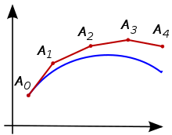
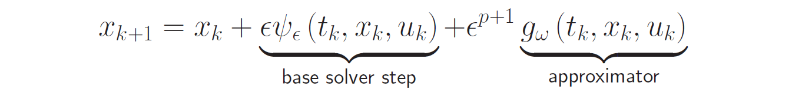
Hypersolvers: Best of Both Worlds?
When solving Differential Equations numerically, we need to take integration steps
For each integration step, we have a discretization error
Hypersolvers: we can learn to correct this error [1]
The error has theoretical bounds, which is very important in practice
.
[1] Poli M, Massaroli S, Yamashita A, Asama H, Park J. Hypersolvers: Toward fast continuous-depth models. NeurIPS 2020
14
Notes:
We get our motivation from the theory of Differential Equations which can be seen as the language of nature and play a prominent role in many disciplines
While classical approaches have been widely used, some of them can be extremely slow or even fail altogether to represent Partial Differential Equations (PDE) behavior
However, since many systems are naturally expressed as graphs, Graph Neural Networks can help to enhance the simulations!

Slide 15
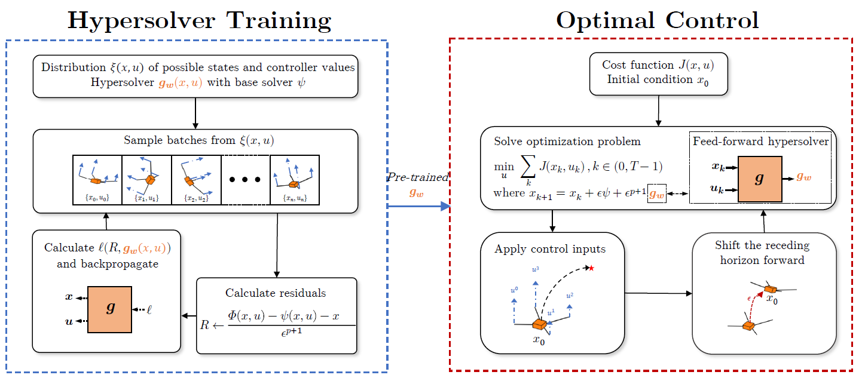
Hypersolvers: an Application to Control
We can apply the idea to speed up optimal control! [1]
.
[1] Berto, Federico, et al. Neural Solvers for Fast and Accurate Numerical Optimal Control. NeurIPS DLDE Workshop, 2021
15
Notes:
We get our motivation from the theory of Differential Equations which can be seen as the language of nature and play a prominent role in many disciplines
While classical approaches have been widely used, some of them can be extremely slow or even fail altogether to represent Partial Differential Equations (PDE) behavior
However, since many systems are naturally expressed as graphs, Graph Neural Networks can help to enhance the simulations!

Slide 16
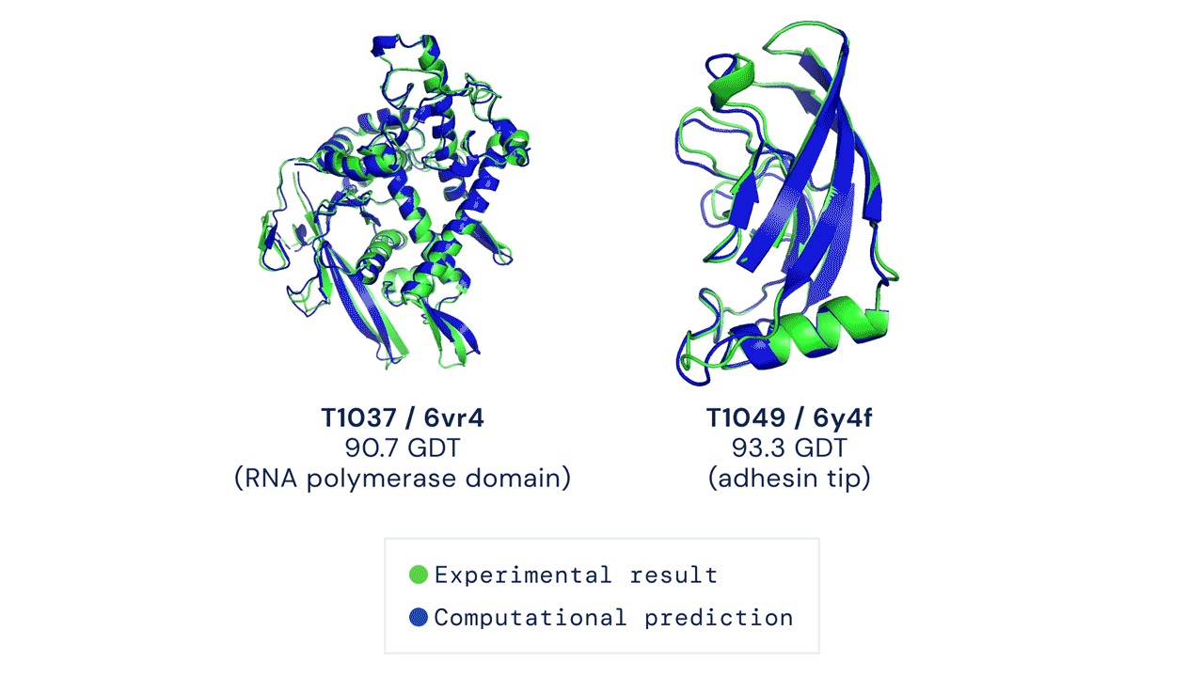
Conclusion
Differential equations describe the reality around us
Differential Equations and Deep Learning are deeply intertwined
We can use Deep Learning to simulate and learn the world we live in!
16
Notes:
We get our motivation from the theory of Differential Equations which can be seen as the language of nature and play a prominent role in many disciplines
While classical approaches have been widely used, some of them can be extremely slow or even fail altogether to represent Partial Differential Equations (PDE) behavior
However, since many systems are naturally expressed as graphs, Graph Neural Networks can help to enhance the simulations!

Slide 17
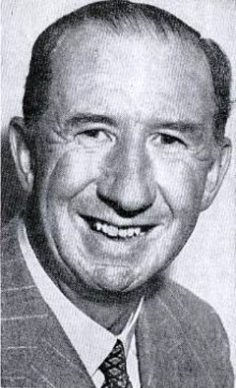
A Final Quote
“Differential equations won't help you much in the design of airplanes — not yet, anyhow.”
Nevil Shute, British Aeronautical Engineer, 1923
After a 100 years, the time has come to design airplanes and so much more!

Slide 18

Thanks for your attention
Do not hesitate to contact us for any doubts or ideas!
Federico Berto
fberto@kaist.ac.kr
18

